Slide 1
CS101 Discussion 12.2
Greedy Algorithm
Topological Sort
Notes:
Adapted from the Lecture slides by Kevin Wayne at http://www.cs.princeton.edu/~wayne/kleinberg-tardos
May also contain material from the slides at https://ece.uwaterloo.ca/~dwharder/aads/Lecture_materials/ (by Dan Suciu of U Washington)

Slide 2
Outline
Greedy Algorithm
Topological Sort

Slide 3
Greedy algorithms
Suppose it is possible to build a solution through a sequence of partial solutions
At each step, we focus on one particular partial solution and we attempt to extend that solution
Ultimately, the partial solutions should lead to a feasible solution which is also optimal
Greedy exchange argument
Modify a solution incrementally by any other algorithm into the solution by your greedy algorithm
Justify the modification doesn’t make the solution worsen.
Your solution is at least as good as that of any other solution (optimal solution).
Notes:
3

Slide 4
Interval scheduling
Job j starts at s_{j} and finishes at f_{j}.
Two jobs are compatible if they don’t overlap.
Goal: find maximum subset of mutually compatible jobs.
a
b
b
c
d
e
jobs d and g
are incompatible
e
f
g
h
h
time
0
1
2
3
4
5
6
7
8
9
10
11
Notes:
Greedy并不是一个明确的方法，他是一个idea，并非所有greedy方法都能work。
考虑这道上课讲过的题。

Slide 5
Interval scheduling: greedy algorithms
Greedy template. Consider jobs in some natural order. Take each job provided it′s compatible with the ones already taken.
[Earliest start time] Consider jobs in ascending order of s_{j}.
[Earliest finish time] Consider jobs in ascending order of f_{j}.
[Shortest interval] Consider jobs in ascending order of f_{j} – s_{j}.
[Fewest conflicts] For each job j, count the number of conflicting jobs c_{j}. Schedule in ascending order of c_{j}.

Slide 6
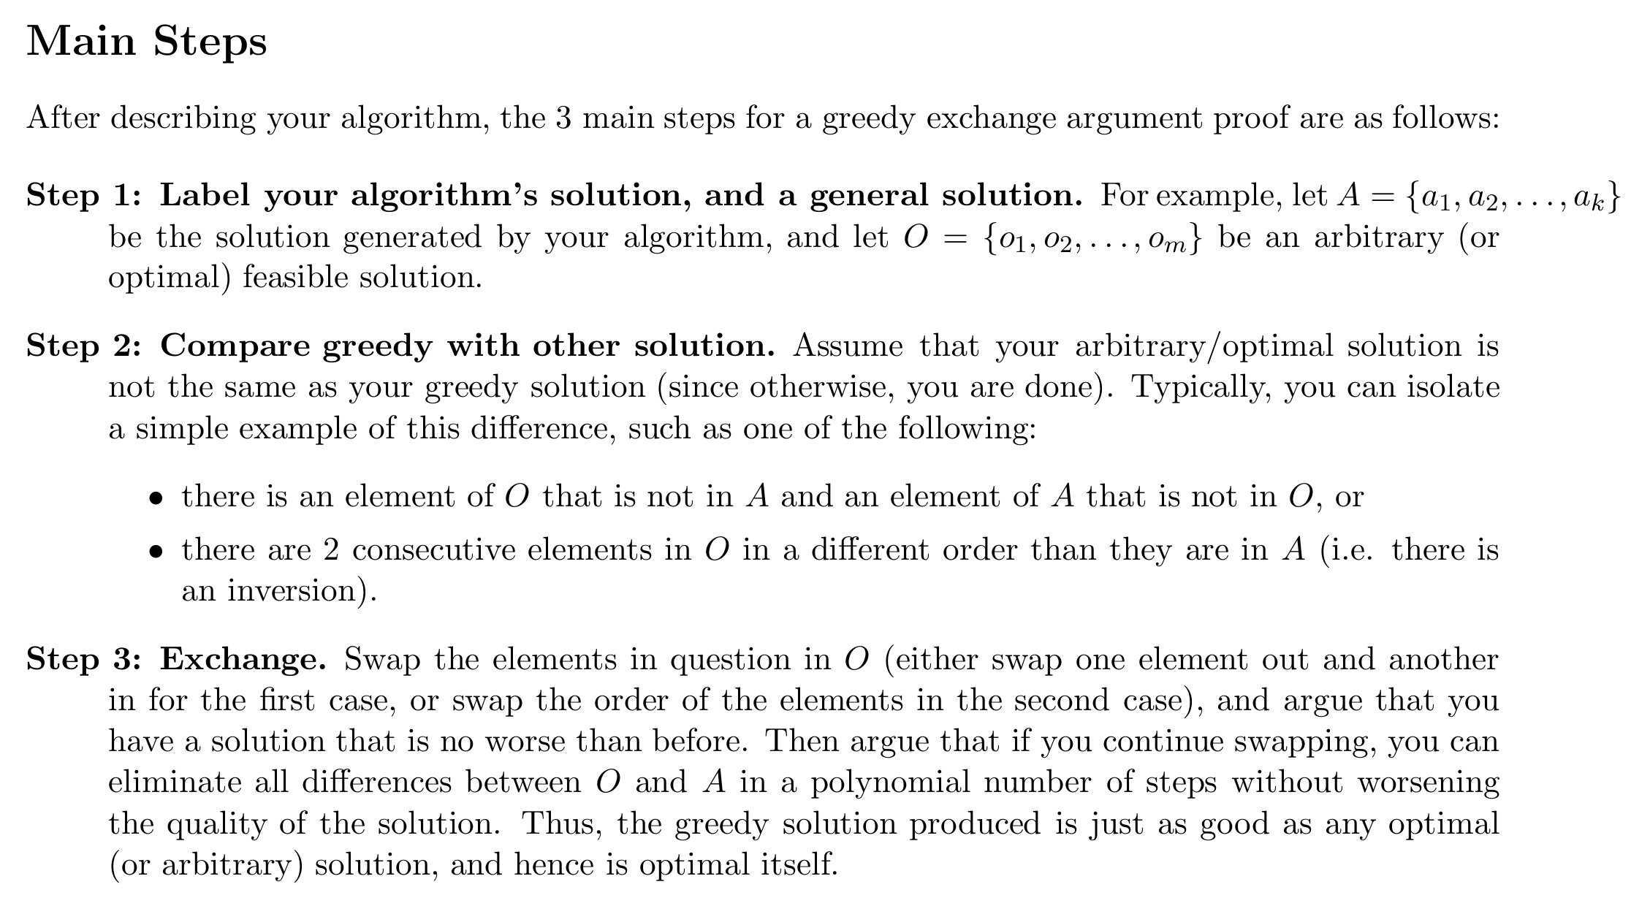
Greedy exchange argument
Notes:
给他们在黑板上做一遍证明。

Slide 7
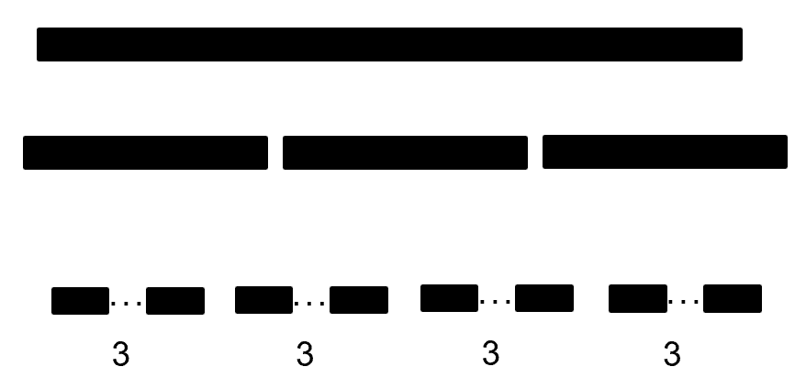
Difference between Greedy and “Divide and conquer”
At each step, we attempt to take the decision that result in the most evident and immediate benefit irrespective of the final outcome. We don’t take future into consideration.
We divide a problem into several non-overlapping subproblem, solve each subproblem indepently and find a way to combine them.
Choose one to add to the bar
VS
Can just be applied to some special cases, but can give optimal results in most times.
Can be applied in nearly every cases, but also not often gives optimal results.
Notes:
Greedy并不一定都是最优的，但他特点是复杂度会比较低。
在做greedy的时候，我们不能一开始确定另一端subproblem是什么。
让我们试一下interval那道题能否用divide and conquer？（不行）

Slide 8
Interval scheduling: analysis of earliest-finish-time-first algorithm
Theorem. The earliest-finish-time-first algorithm is optimal.
Pf. [by contradiction]
Assume greedy is not optimal, and let’s see what happens.
Let i₁, i₂, ... i_{k} denote set of jobs selected by greedy.
Let j₁, j₂, ... j_{m} denote set of jobs in an optimal solution with i₁ = j₁, i₂ = j₂, ..., i_{r} = j_{r} for the largest possible value of r.
1. job i_{r+1} exists and finishes no later than j_{r+1}
i₁
i₂
i_{r}
i_{r+1}
. . .
i_{k}
Greedy:
j₁
j₂
j_{r}
j_{r+1}
. . .
j_{m}
Optimal:
job j_{r+1} exists
because m > k
why not replace
job j_{r+1} with job i_{r+1}?
Notes:
job j_r+1 exists because m > k (by assumption, greedy is not optimal)
job i_r+1 exists because optimal schedule does same thing for first r jobs, so greedy would schedule some job next

Slide 9
Interval scheduling: analysis of earliest-finish-time-first algorithm
Theorem. The earliest-finish-time-first algorithm is optimal.
Pf. [by contradiction]
Assume greedy is not optimal, and let’s see what happens.
Let i₁, i₂, ... i_{k} denote set of jobs selected by greedy.
Let j₁, j₂, ... j_{m} denote set of jobs in an optimal solution with i₁ = j₁, i₂ = j₂, ..., i_{r} = j_{r} for the largest possible value of r.
2. job i_{k} finishes no later than j_{k}, but m > k, the greedy algorithm should not stop, as job j_{k+1} can be chosen
i₁
i₂
i_{r}
i_{r+1}
. . .
i_{k}
Greedy:
j₁
j₂
j_{r}
j_{r+1}
. . .
j_{m}
Optimal:
Notes:
job j_r+1 exists because m > k (by assumption, greedy is not optimal)
job i_k+1 exists because optimal schedule does same thing for first k jobs, so greedy would schedule some job next

Slide 10
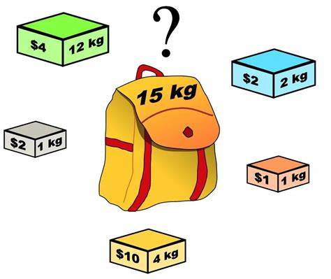
Don’t be too greedy
Suppose we have a bag with a fixed capacity, and several items, each with a specific value and weight. The goal is to fill the bag with the maximum possible value. Which of the following scenarios can be solved using a greedy algorithm?
There are no special conditions.
The items can be divided into fractions and placed in the bag.
The same item can be placed in the bag multiple times.
The bag can hold exactly three items, with no capacity restriction.
Notes:
第一个选项因为可以拆开所以都是可以的
第二个就不行
10

Slide 11
Don’t be too greedy
Suppose we have a bag with a fixed capacity, and several items, each with a specific value and weight. The goal is to fill the bag with the maximum possible value. Which of the following scenarios can be solved using a greedy algorithm?
There are no special conditions.
The items can be divided into fractions and placed in the bag.
The same item can be placed in the bag multiple times.
The bag can hold exactly three items, with no capacity restriction.
Notes:
第一个选项因为可以拆开所以都是可以的
第二个就不行
11

Slide 12
Greedy algorithms so far
· Kruskal
· Prim
· Disjktra
· Huffman coding

Slide 13

Can this be solved in greedy method?

Slide 14
Outline
Greedy Algorithm
Topological Sort

Slide 15
Topological Sort
DAG: Directed acycli graph （有向无环图）
Theorem:
A graph is a DAG if and only if it has a topological sorting
Proof strategy:
Two lemmas:
A DAG always has at least one vertex with in-degree zero
2. Any sub-graph of a DAG is a DAG

Slide 16
Topological Sort
We will start with showing a → b:
If a graph is a DAG, it has a topological sort
Proof by induction:
A graph with one vertex is a DAG and it has a topological sort
Assume a DAG with n vertices has a topological sort
A DAG with n + 1 vertices must have at least one vertex v of in-degree zero
Removing the vertex v and consider the vertex-induced sub-graph with the remaining n vertices
If this sub-graph has a cycle, so would the original graph—contradiction
Thus, the graph with n vertices is also a DAG, therefore it has a topological sort
Add the vertex v to the start of the topological sort to get one for the graph of size n + 1

Slide 17
Topological Sort
Next, we will show that b → a:
If a graph has a topological ordering, it must be a DAG
We will show this by showing the contrapositive: ¬a → ¬b:
If a graph is not a DAG, it does not have a topological sort
By definition, it has a cycle: (v₁, v₂, v₃, …, v_{k}, v₁)
In any topological sort, v₁ must appear before v₂, because (v₁, v₂) is a path
However, there is also a path from v₂ to v₁: (v₂, v₃, …, v_{k}, v₁)
Therefore, v₂ must appear in the topological sort before v₁
This is a contradiction, therefore the graph cannot have a topological sort
∴ a ↔ b: A graph is a DAG if and only if it has a topological sorting

Slide 18
Topological Sort
Idea:
Given a DAG V, iterate:
Find a vertex v in V with in-degree zero
Let v be the next vertex in the topological sort
Continue iterating with the vertex-induced sub-graph V \ {v}.
Property:
Topological sorts need not be unique:
We can choose any vertex with the same in-degree
We may use a table of the in-degrees of each of the vertices, which requires Θ(|V|) memory
Notes:
如果只用table去存储每个点的in-degree的话，当我们想要找到in-degree为0的点我们就必须把点全遍历一遍。
更好的方法是我们把indegree为0的点放到queue里，这样就不用每次再遍历一遍indegree的表了。

Slide 19
What are the run times associated with the queue?
Initially, we must scan through each of the vertices: Θ(|V|)
For each vertex, we will have to push onto and pop off the queue once, also Θ(|V|)
Finally, every time we remove a vertex v, all its edges shall also be removed and the in-degree table be updated
The run time of these operations is Ω(|E|)
If we are using an adjacency matrix: Θ(|V|²)
If we are using an adjacency list: Θ(|E|)

Slide 20
Therefore, the run time of a topological sort is:
Θ(|V| + |E|) if we use an adjacency list
Θ(|V|²) if we use an adjacency matrix
and the memory requirements is Θ(|V|)
We could also use this method to determin if a graph has a cycle by checking the in-degree.
Notes:
在实战中我们偏向用array来实现我们的queue。因为我们每个点只会放进queue一次，不用resize也不用考虑queue循环的问题。
Most importantly, however, because of the properties of a queue
When we finish, the underlying array stores the topological sort

Slide 21
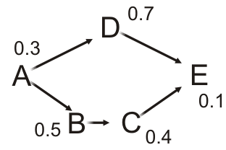
Critical path
The critical time of each task is the earliest time that it could be completed after the start of execution
The critical path is the sequence of tasks determining the minimum time needed to complete the project
If a task on the critical path is delayed, the entire project will be delayed
Notes:
Critical path和time的定义来源是因为，在实际处理问题的时候，有些互不影响的任务我们是可以并行运作的。我们希望找到使用这种并行的情况下最少所需要完成任务的时间。

Slide 22
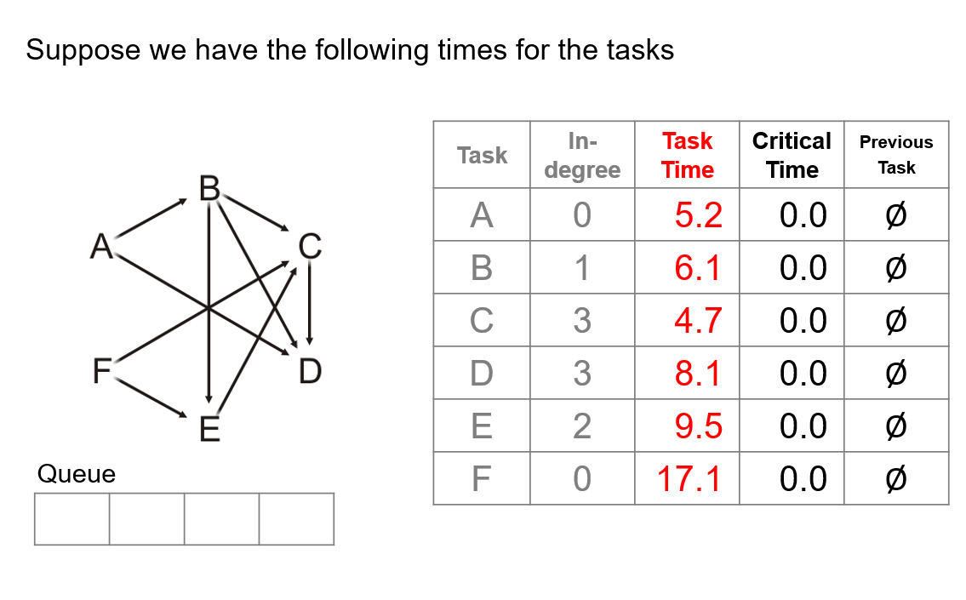
Notes:
实际解决问题的时候我们也可以做这样的表，其中的previous task就是我们必须等待的前一个task，更新完表后我们可以逆推地找到这个图的critical path。

Slide 23


